Slide 1
Real Estate Market Analysis: Key Insights and Trends
Modiba Tumi & Faeik Eldeib Imad

Slide 2
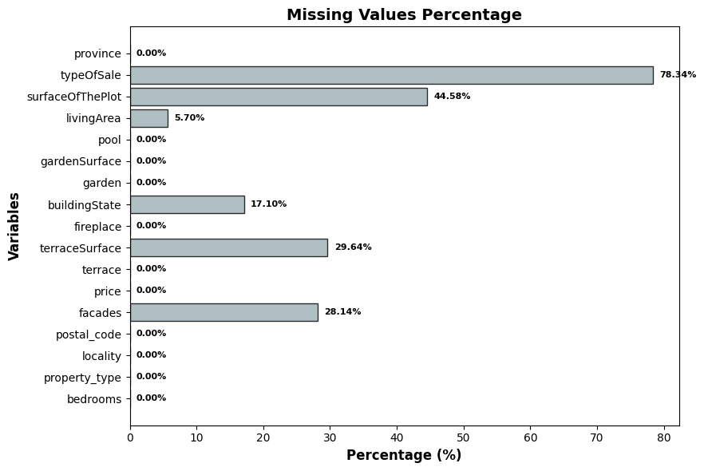
DATASET OVERVIEW
Dropped unnecessary columns (e.g., property_subtype)
Transformed qualitative variables into quantitative ones (e.g., buildingState)
Handled missing values in columns such as typeOfSale
Dropped columns with redundant information (e.g., garden, gardenSurface, terrace, terraceSurface)

Slide 3
 | Before |  |  |  | After
Province | Mean | Median | Std Dev |  | Mean | Median | Std Dev
Antwerp | 465,19 | 355 | 426,825 |  | €420,248 | €349,000 | €252,092
Brussels | 465,36 | 350 | 385,709 |  | €436,341 | €349,000 | €273,890
East Flanders | 422,97 | 349,7 | 299,595 |  | €400,176 | €349,000 | €214,831
Flemish Brabant | 487,46 | 399 | 300,735 |  | €467,194 | €399,000 | €247,620
Hainaut | 312,84 | 279 | 186,269 |  | €307,290 | €275,000 | €178,152
Limburg | 423,37 | 335 | 290,338 |  | €397,607 | €329,000 | €235,981
Liège | 313,12 | 265 | 226,766 |  | €302,304 | €264,750 | €167,410
Luxembourg | 379,17 | 320 | 236,841 |  | €372,139 | €320,000 | €220,129
Namur | 299,82 | 290 | 132,85 |  | €299,467 | €290,000 | €133,045
Walloon Brabant | 515,52 | 425 | 393,45 |  | €459,708 | €417,000 | €220,350
West Flanders | 610,99 | 369 | 735,85 |  | €462,677 | €349,000 | €334,263
Dropped Obvious Outliers
Difference between Mean/Median
Standard Deviation (std) to identify the values distribution
Outlier Removal through Price and LinvingArea
Removed 2048 rows based on IQR
Removed 454 rows based on Z-scores

Slide 4
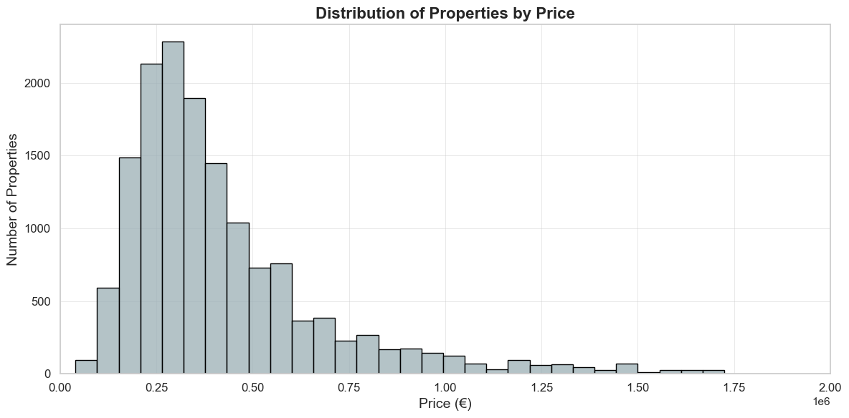

Slide 5
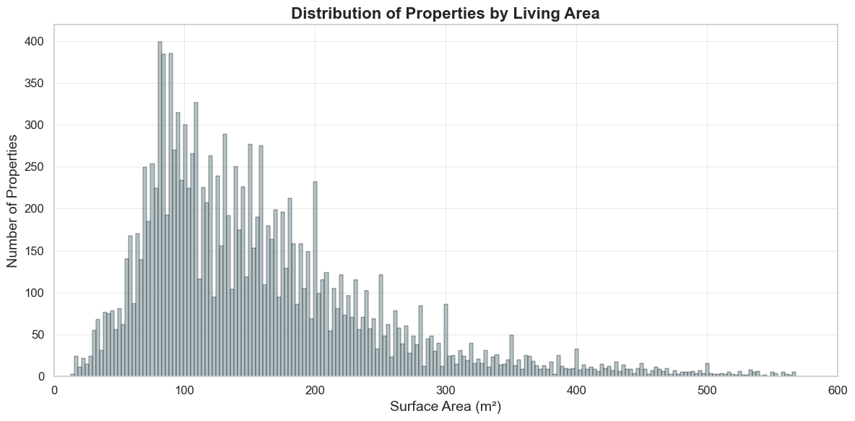

Slide 6
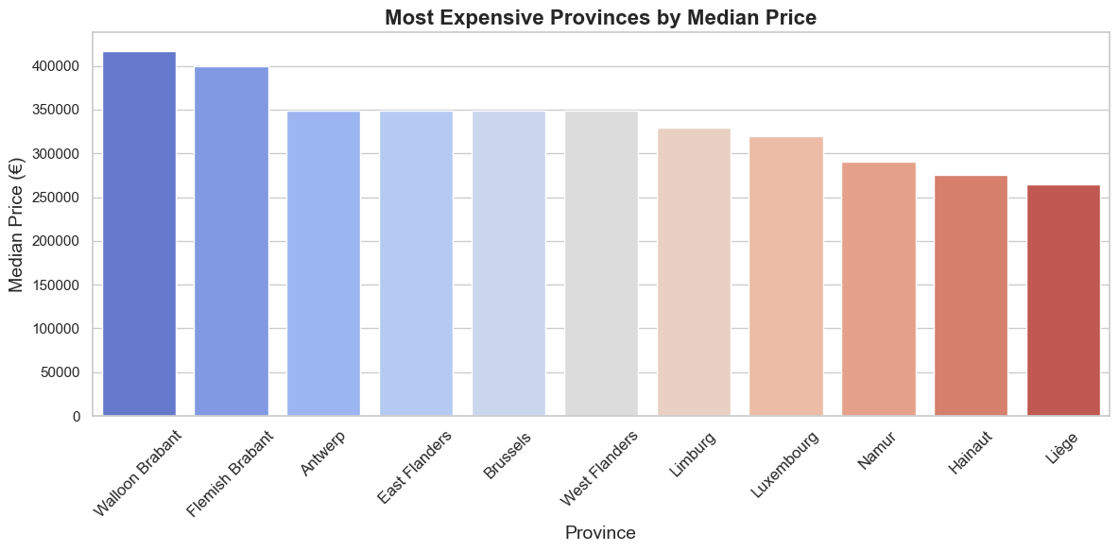

Slide 7
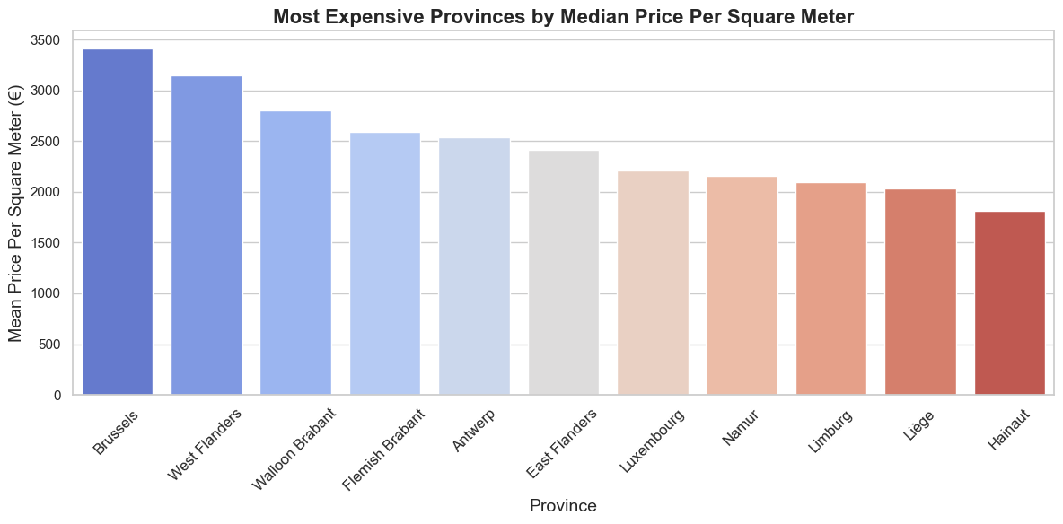

Slide 8
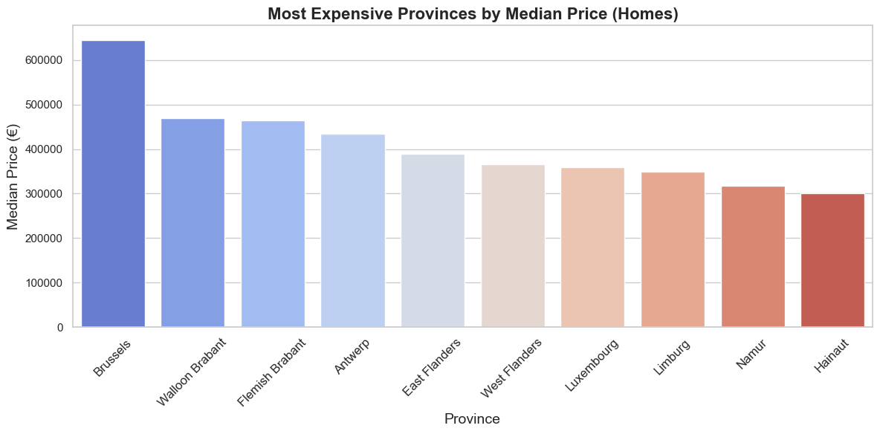

Slide 9
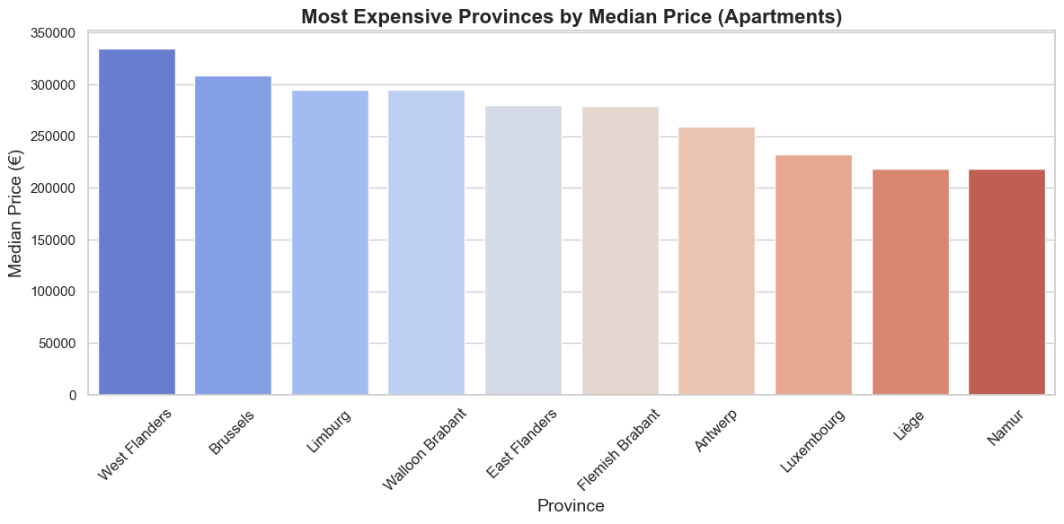

Slide 10
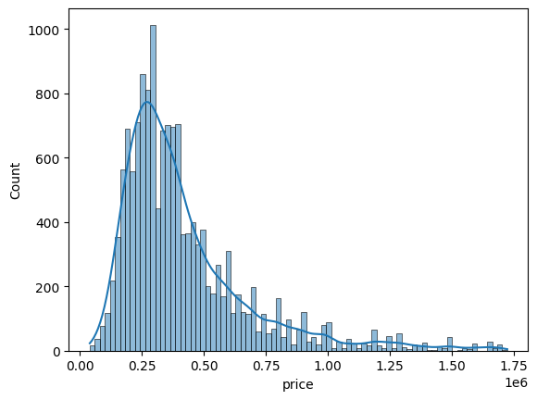
Distribution of prices across our dataset

Slide 11
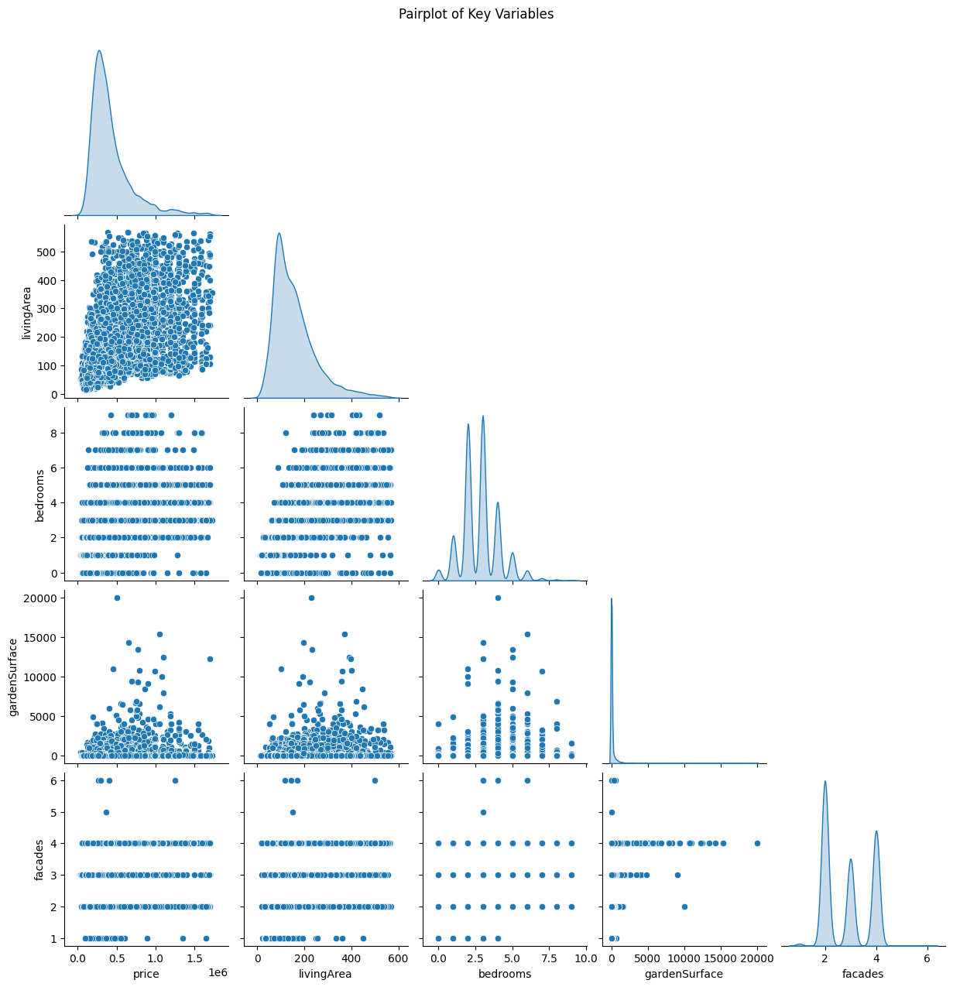
Relationships between key or seemingly important variables.
Living area shows a close to linear increase in price
There appears to be some correlation between garden surface & living area in the similarity of the scatter plot.
With bedrooms, garden and facades its difficult to see a correlation in price
Distribution of values against the same variable appears to be the most significant on this chart

Slide 12
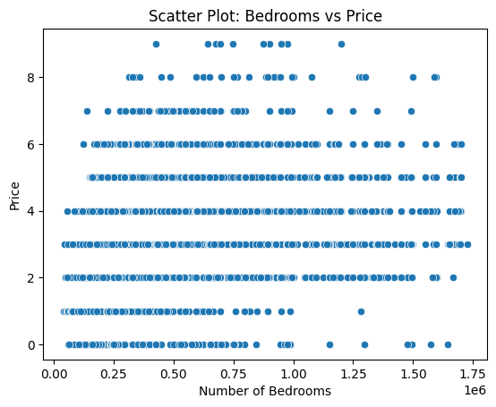
Scatter Plot of Bedroom Count VS Price
On closer view, its still difficult to gain insight on this metric.

Slide 13
Bedroom Median Average & Price Median Average Across the provinces
 | Province | Median Price | Mean Bedrooms
 | Walloon Brabant | 425 000 | 3.2
 | Flemish Brabant | 398 000 | 3
 | Antwerp | 349 000 | 2.8
 | Brussels | 349 000 | 2.4
 | East Flanders | 349 000 | 2.9
 | West Flanders | 349 000 | 2.5
 | Limburg | 328 000 | 3
 | Luxembourg | 317 500 | 3.3
 | Namur | 289 000 | 2.9
 | Hainaut | 275 000 | 3.2
 | Liège | 260 000 | 2.9

Slide 14
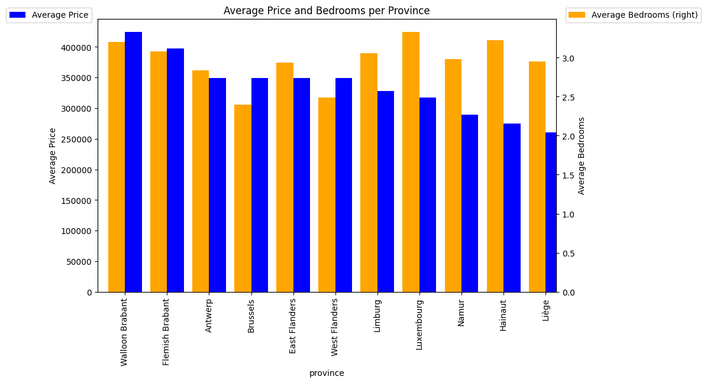
In Graph format
We can see from here that there is more correlation between the bedrooms and price in different regions

Slide 15
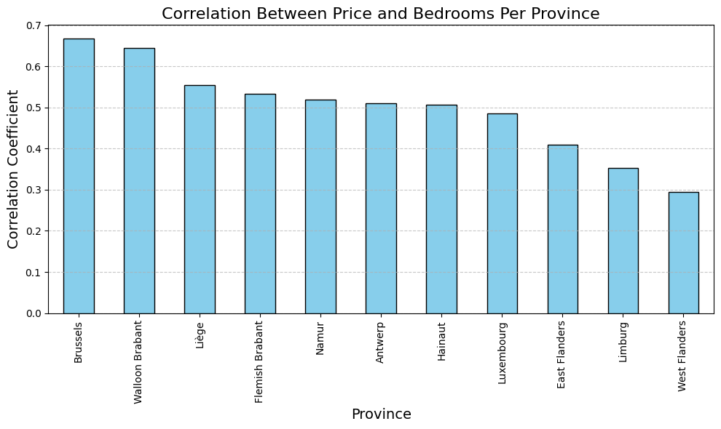
Correlation of bedrooms to price
Correlation Coefficient for Bedroom count against price in Belgium= 0.4093591456634096

Slide 16
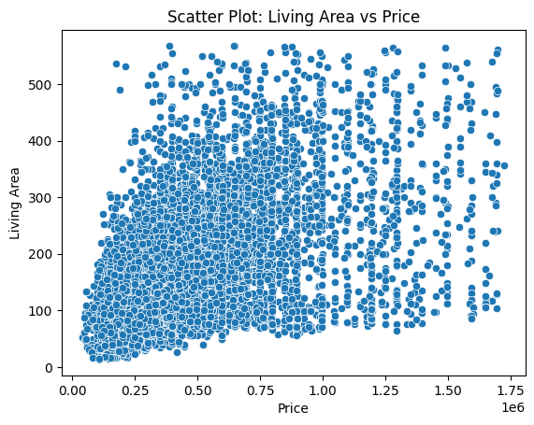
Scatter Plot: Living Area VS Price

Slide 17
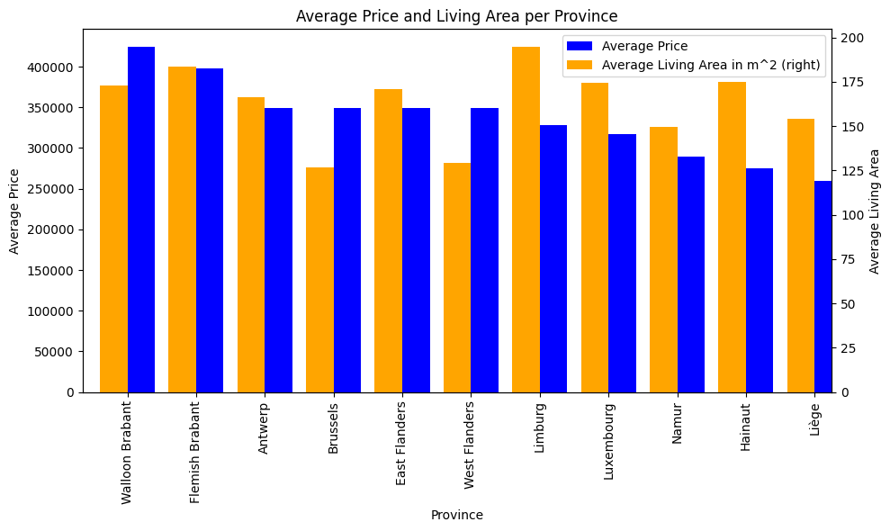

Correlation Coefficient for Living Area against price in Belgium = 0.5418748219987014
There appears to be some correlation between living area ad price
This correlation however appears more heavily weighted in different regions
In Brussels not as significant where in Linburg one gets a greater living area for the price

Slide 18
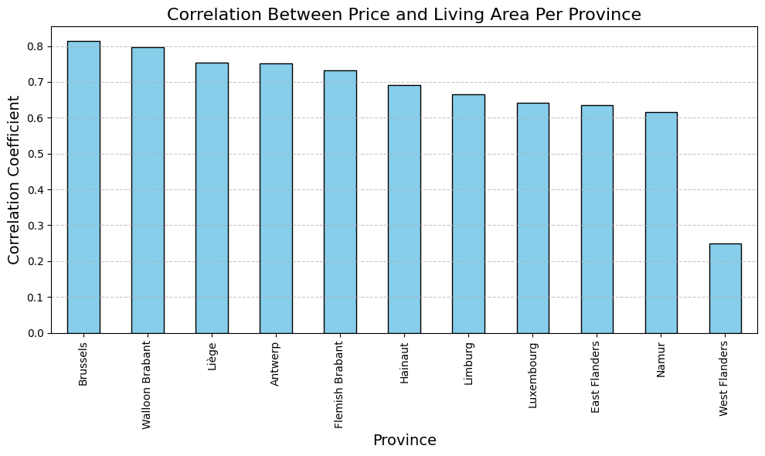

Slide 19
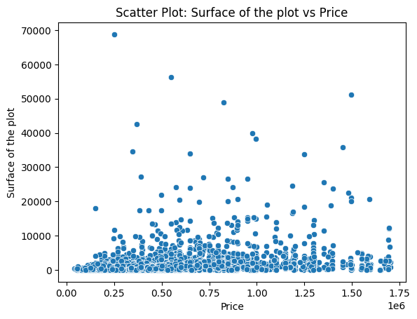
Surface of the plot vs Price
Correlation Coefficient for Surface Area against
price in Belgium = 0.28959672063355135
There does not seem to be a clear correlation.
The correlation coefficient is still positive but smaller than the others we've seen thus far
Many properties with a small surface area still have price equality to larger surface areas

Slide 20
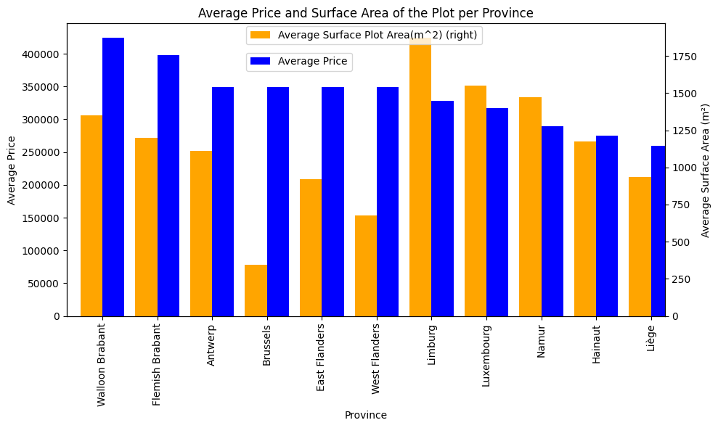
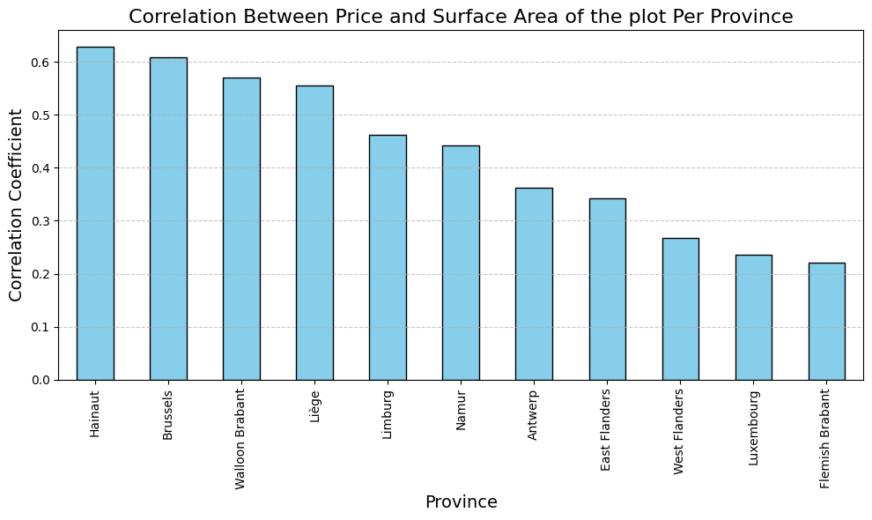
Correlation Coefficient between Surface Area of plot and the Price per Province
Distribution of Surface Area of plot per Province

Slide 21
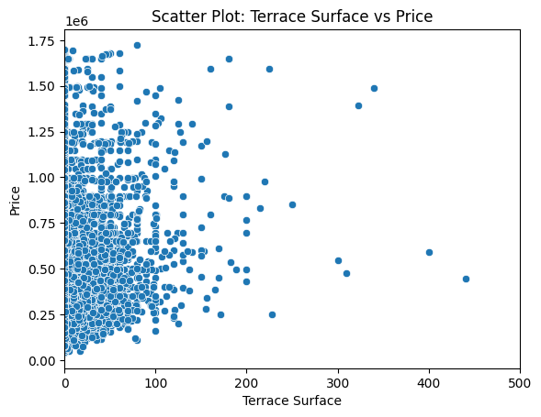

Slide 22
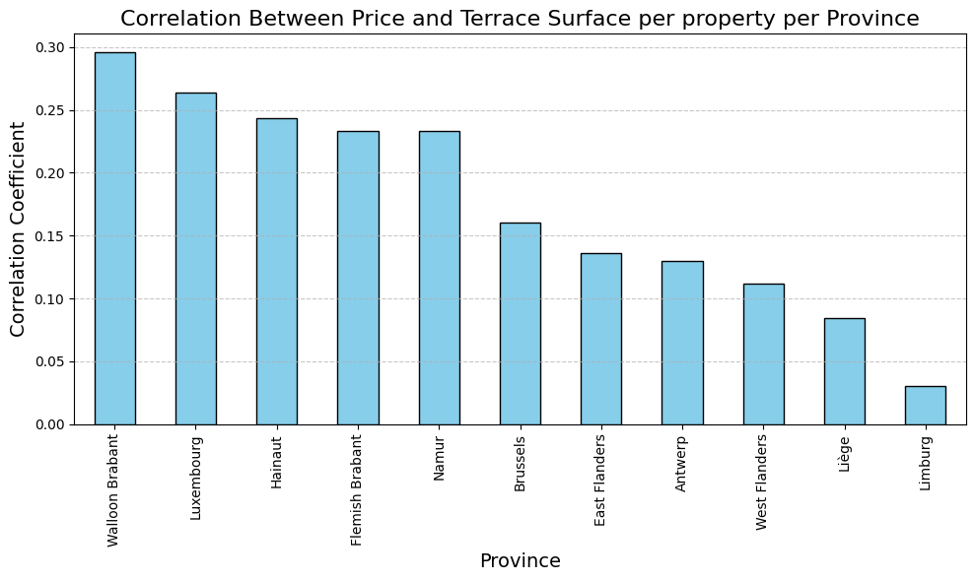
Correlation Coefficient for Terrace Surface Area against
price in Belgium = 0.28959672063355135
The correlation appears to be more significant in certain areas vs others.
I think this has to do with the proximity to central business districts and how popular the regions are.
This would also affect the population of the region and space available to build or buy larger properties

Slide 23
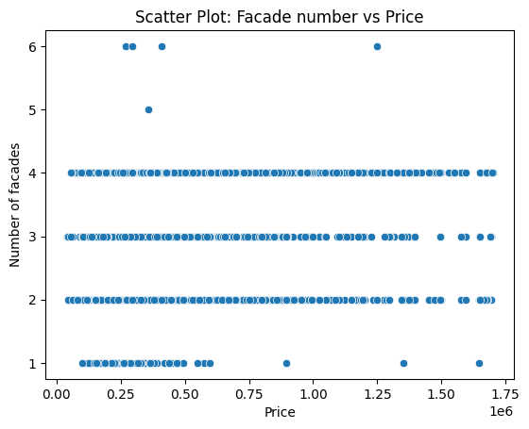
Façade count per property vs Price
Due to the steps in the graph its difficult to see the relationship between the price and facades

Slide 24
Façade count per property vs Price
Due to the steps in the graph its difficult to see the relationship between the price and facades

Slide 25
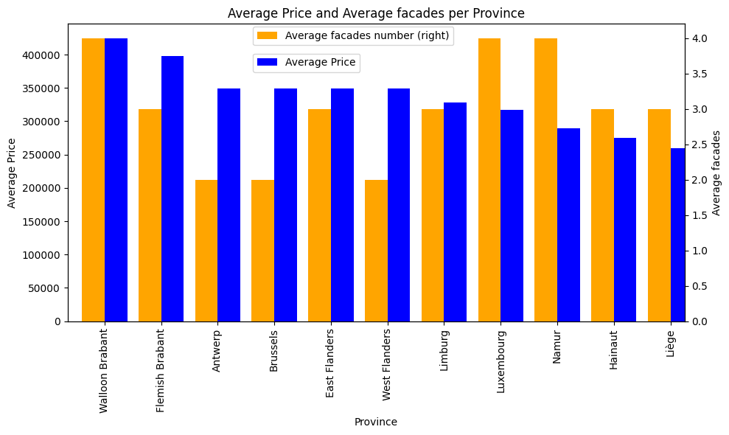

Slide 26
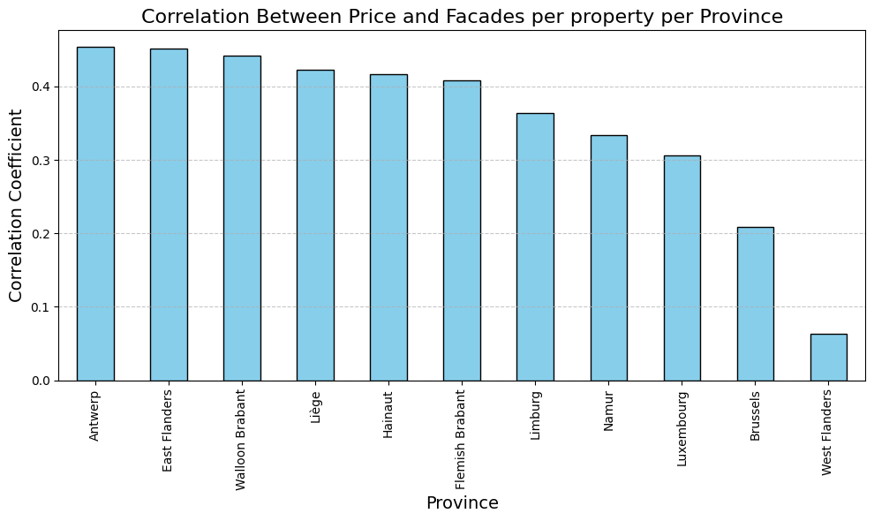

Slide 27
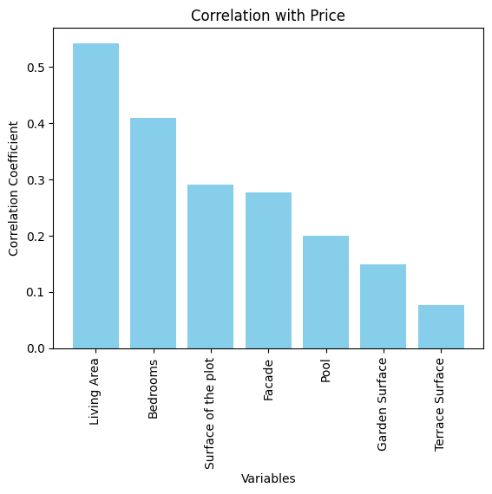
Correlation coefficient Summary against variables

Slide 28
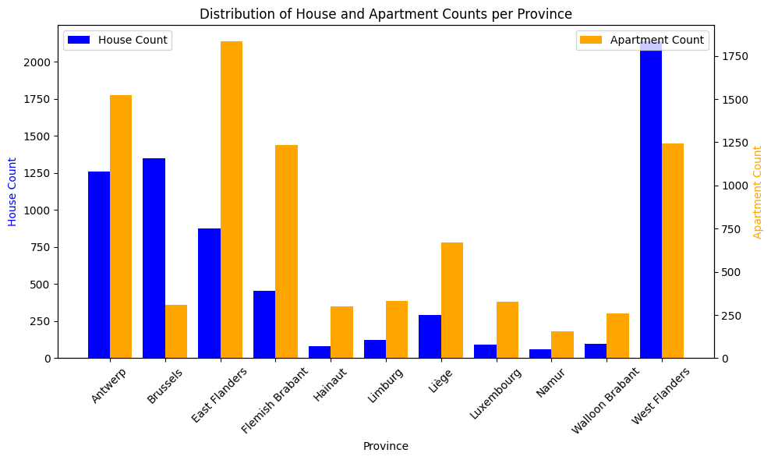

Slide 29
